Slide 1
<Odin1.PS1>-C1 (Inlet Waterway)
Creek intake
_______
Surge Shaft/Chamber
_______
Tunnel intake
_______
Reservoir
<Odin1.PS1>-E1
Emergency
Closing Valve
_______
Inlet tunnel, part 1
_______
Pressure shafts
1,2 and 3
Inlet tunnel, part 2
_______
- _______
_______
_______
Penstock
<Odin1.PS1>-A1.KA1 (Unit 1, MIV)
<Odin1.PS1>-A2.KA1 (Unit 2, MIV)
<Odin1.PS1>-A3.KA1 (Unit 3, MIV)

Slide 2
<Odin1.PS1>-C1 (Inlet Waterway)
Creek intake
-C1.HB1
Surge Shaft/Chamber
-C1.PF1
Tunnel intake
-C1.KA1
Reservoir
<Odin1.PS1>-E1
Emergency
Closing Valve
-C1.KA2
Inlet tunnel, part 1
-C1.JB11
Pressure shafts
1,2 and 3
Inlet tunnel, part 2
-C1.JB12
-C1.JB21
-C1.JB22
-C1.JB23
Tunnel
Penstock
<Odin1.PS1>-A1.KA1 (Unit 1, MIV)
<Odin1.PS1>-A2.KA1 (Unit 2, MIV)
<Odin1.PS1>-A3.KA1 (Unit 3, MIV)

Slide 3







CCPP
Combined cycle power plant
Boiler
Gas
Demineralization
Steam
Steam turbine
Residual heat
(air)
Combustion
Pump
Generator
Compressor
Water
Generator
Cooling Water
Gas turbine
Air
Condenser
Cooling

Slide 4
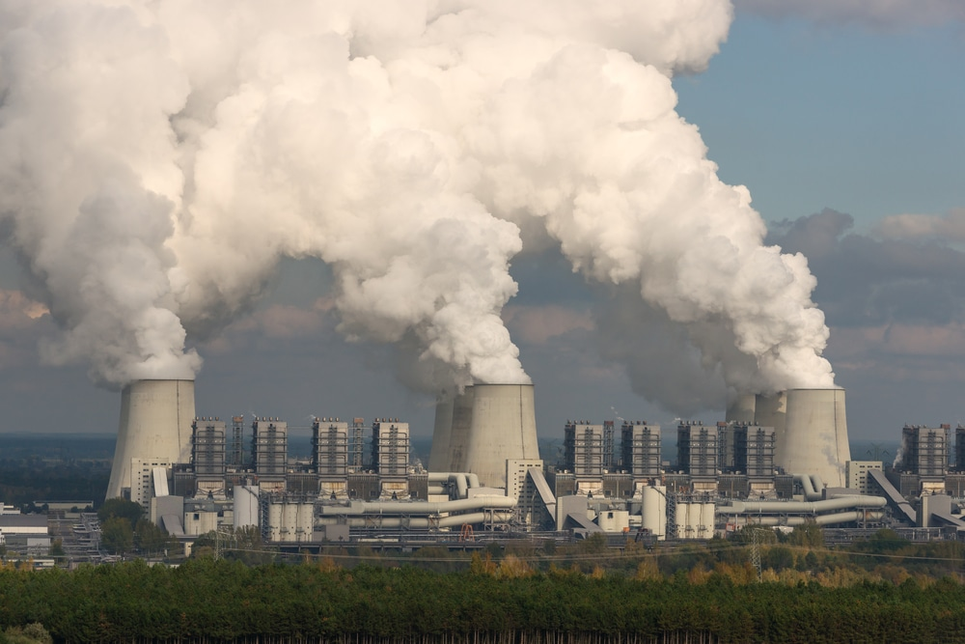
CCPP
Combined cycle power plant
Boiler
Gas
Demineralization
Steam
Steam turbine
Residual heat
(air)
Combustion
Pump
Generator
Compressor
Water
Generator
Cooling Water
Gas turbine
Air
Condenser
Cooling

Slide 5
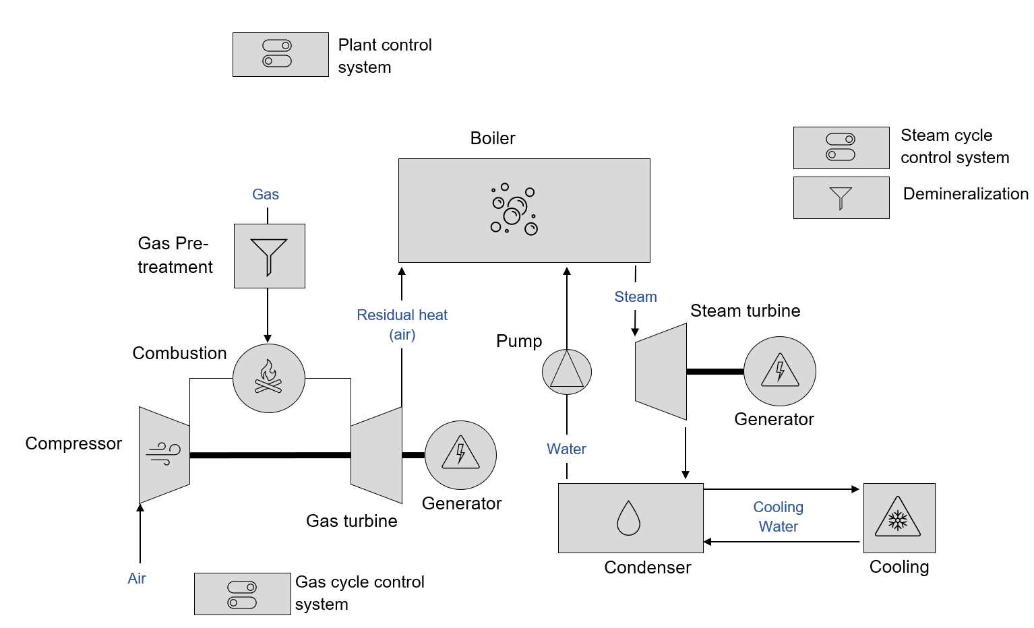







CCPP
Combined cycle power plant
Group:___

Slide 6






CCPP
Combined cycle power plant
Group:___

Slide 7

CCPP
=F1 Plant governing system
Plant control system
Combined cycle power plant
=A2 Steam Unit
=A1 Gas Unit
=HA1
Steam cycle control system
Boiler
=LA1
Gas
=KC1
Demineralization
=KC1
Gas Pre-treatment
Steam
=RC1
Residual heat
(air)
Steam turbine
=RD1
=KE1
Combustion
Pump
=RA1
=HA1
Generator
Compressor
=RA1
Water
=RC1
Generator
Gas turbine
Cooling Water
Air
Condenser
Cooling
Gas cycle control system
=HE1
=HE2
=LA1

Slide 8
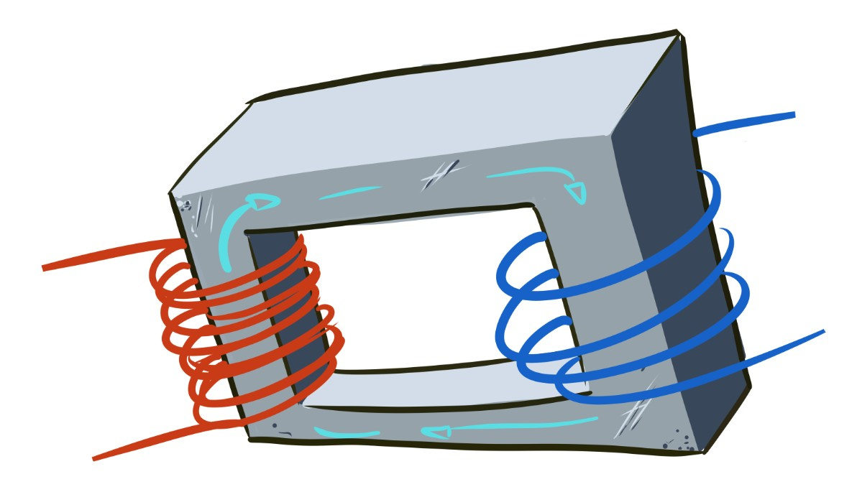
=A1.JE1.KF1
Unit 1, Switch gear system, Unit transformer
KF - treatment system for transforming electrical energy

Slide 9
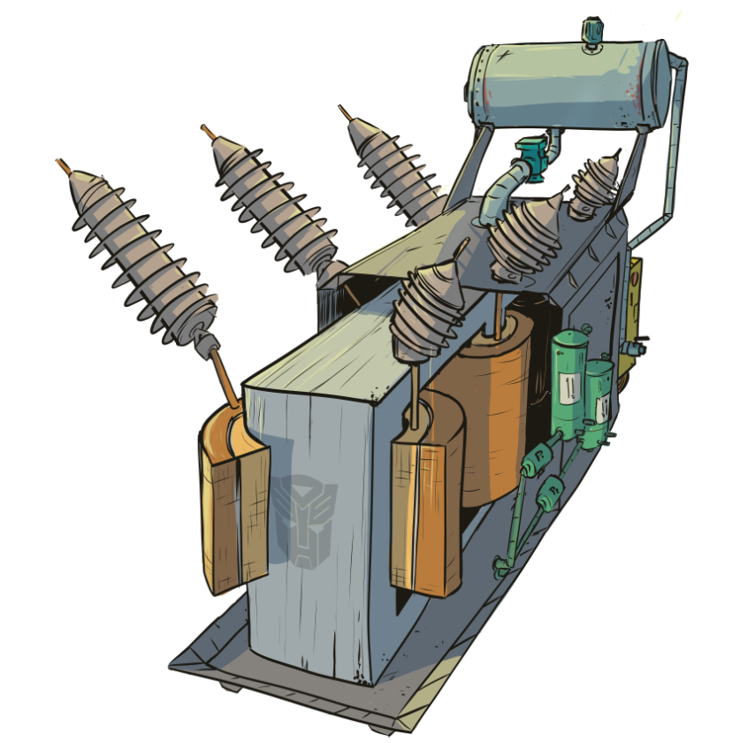
- PRODUCT
Breather
Conservator
Bushholtz relay
HV Bushing (x3)
LV Bushing (x3)
Automation system
Oil extraction
HV Winding, L1
Oil coolers (water)
LV Winding, L1
Oil circulation pumps (water)
Inter-winding insulation, L1
Core

Slide 10
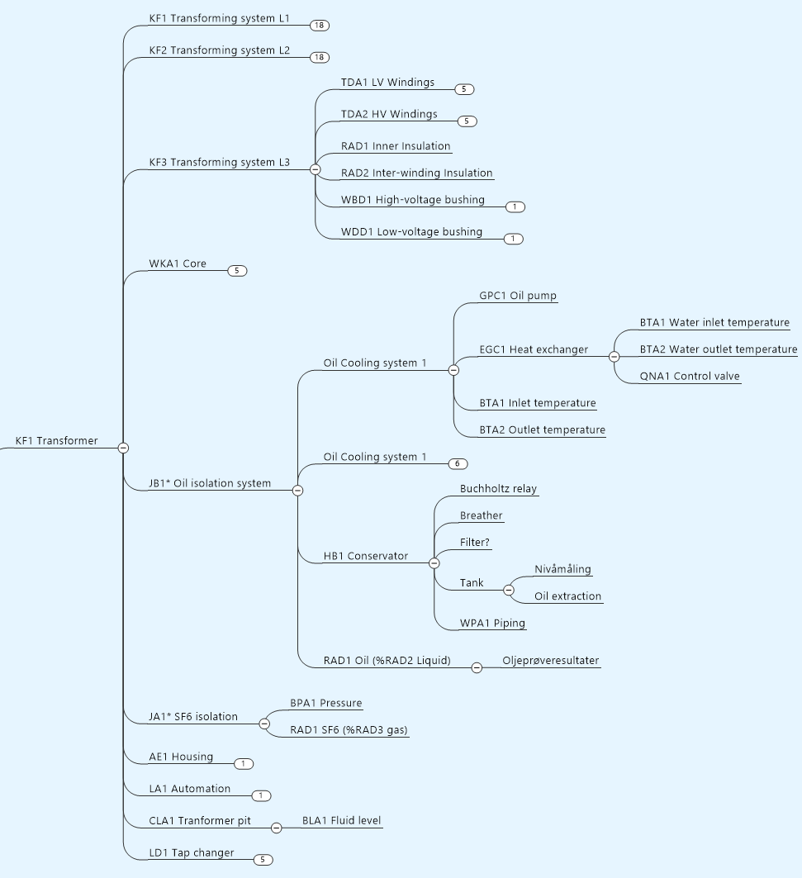
- PRODUCT

Slide 11
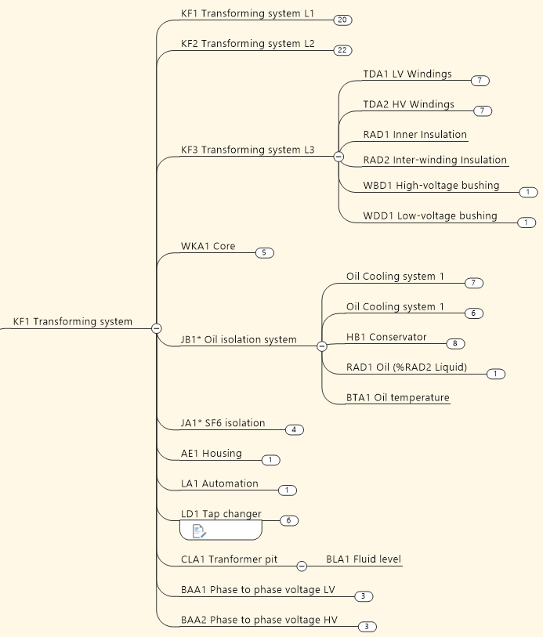
= Function

